Slide 1
Evidence Based ?
A 6½ minute introduction

Slide 2
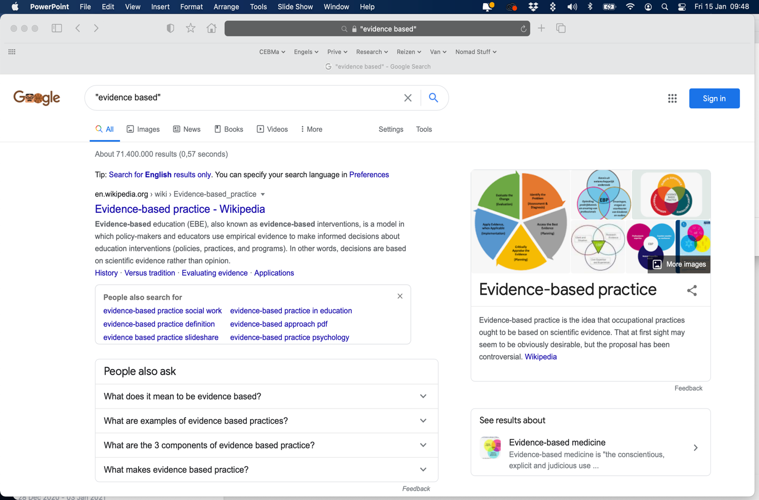

Slide 3
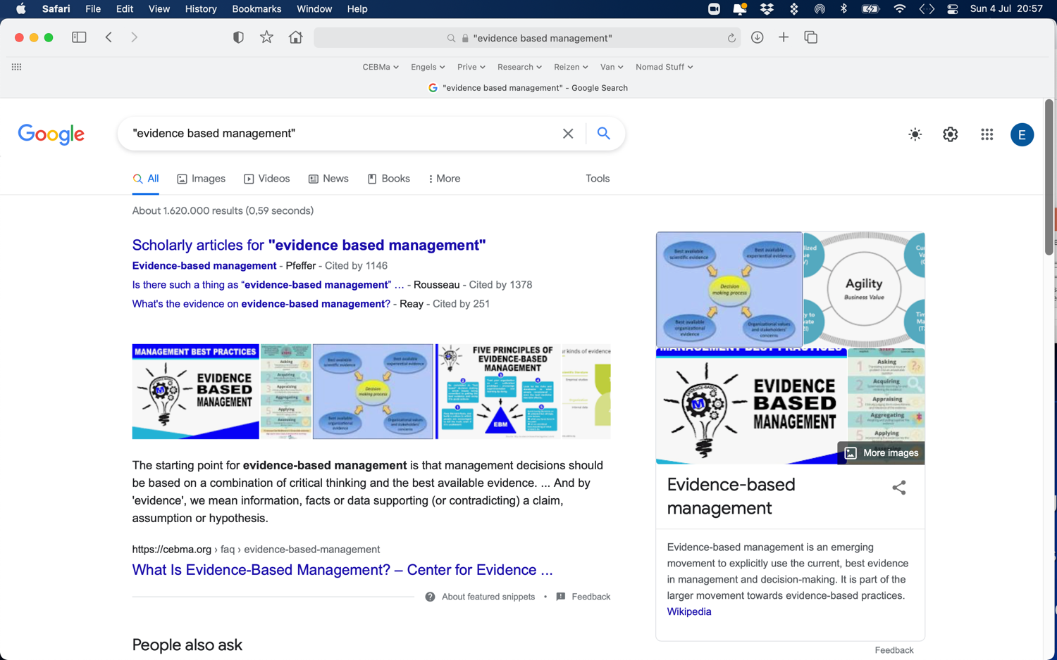

Slide 4
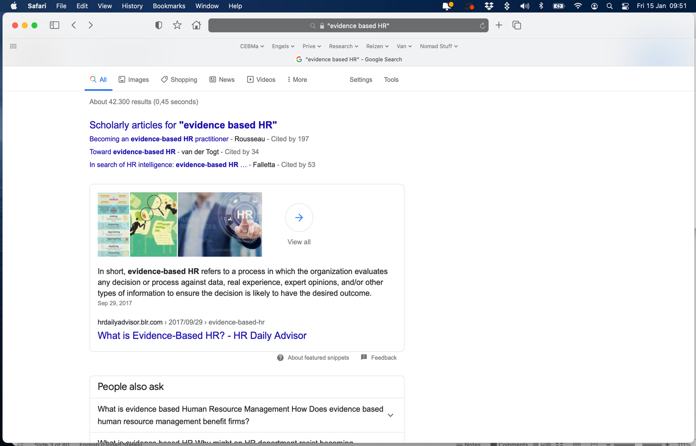

Slide 6
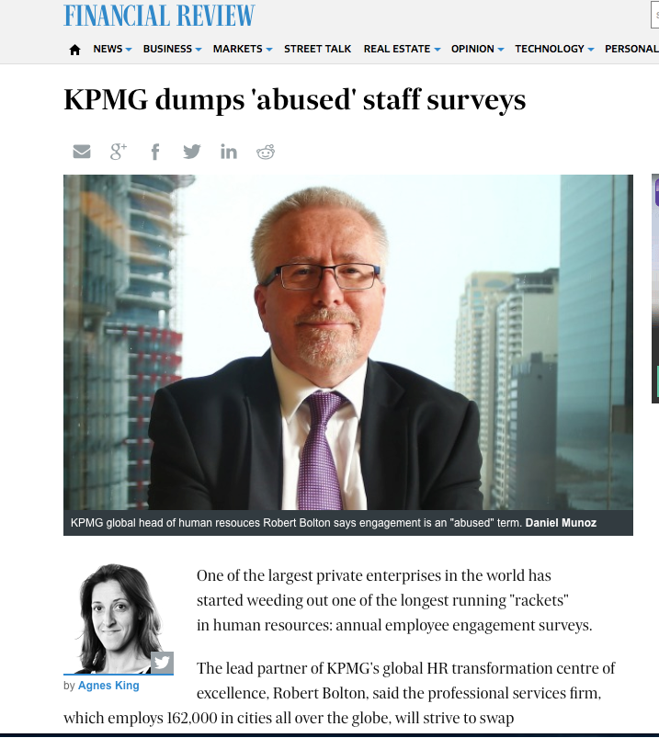

Slide 9
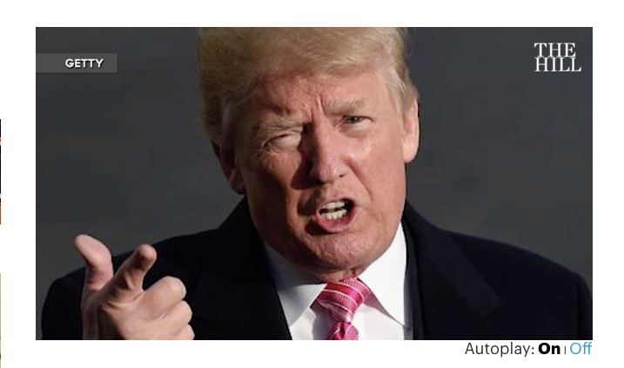

Slide 10
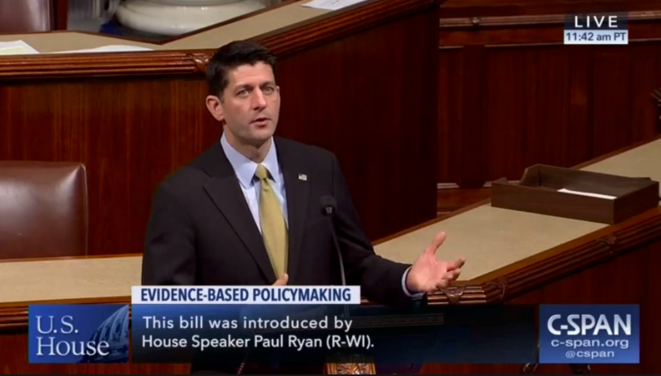
On January 14, 2019, the Foundations for
Evidence-Based Policymaking Act was signed into law

Slide 11
Evidence based management?
Never heard off
Heard off
Heard off and can explain

Slide 13
Evidence-based decision-making
Central Premise:
Decisions should be based on
the ‘best available evidence‘.

Slide 14
Evidence?
information, facts or data supporting (or contradicting) a claim, assumption or hypothesis

Slide 15
Source?
outcome of scientific research, organizational data, benchmarking, best practices, personal experience

Slide 16
“But … then we all base our decisions on ‘evidence’”

Slide 17
Yes, but…most people pay little or no attention to
the strength of the evidence
and base their decisions on
too few sources of evidence

Slide 18
Trust me, 20 years of management experience

Slide 19
Sources of evidence
Scientific literature
empirical studies
Practitioners
professional expertise
Ask
Acquire
Appraise
Aggregate
Apply
Assess
problem
solution
Organization internal data
Stakeholders
values and concerns

Slide 20
Evidence-based … whatever
=
The use of critically evaluated evidence from multiple sources to increase the likelihood of a favourable outcome

Slide 21
It’s a structured and stepped process!

Slide 22
15 Online learning modules

Slide 23
What’s in the course modules?
Explanatory content
Learn By Doing activities, giving you chance to practice the concept that you are learning, with hints and feedback to guide you if you struggle.
Did I Get This activities, giving you the chance to do a quick "self-check" and assess your understanding of the material before doing a graded activity.
Assessment Quiz > 3 attempts, 70% or more
Podcasts
Exercises

Slide 24
Assessment > for you & for us

Slide 25
Assessment > for you & for us

