Slide 1
Improving Outcomes for Aboriginal Communities
Building an Evidence Base

Slide 3
What we will talk about
Background on VACCA
VACCA’s context
VACCA’s work to develop outcomes and build an evidence base of Aboriginal programs
What we have learnt

Slide 4
VACCA
Aboriginal Community Controlled Organisation - established in 1977
Vision: Aboriginal self-determination- Live, Experience and Be
Purpose: Supporting culturally strong, safe and thriving Aboriginal communities
Principles:
Best interest of the child
Aboriginal Cultural Observance
Respect
Self Determination
Healing and Empowerment
Excellence

Slide 5
Context
Use of evidence and outcomes measurement
Funding environment encouraging use of evidence- based programs (EBPs)
Lack of Aboriginal EBPs
Limited applicability of EBPs in our context, lack of cultural outcomes and lack of alignment of EBPs with the right to self-determination
Western evaluation methods and approaches not always the right fit

Slide 6
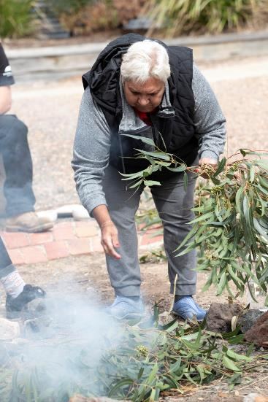
Our approach to evidence
Context is critical for program design
Evidence needs to be relevant
Outcomes need to be important to our communities
Evaluations - supporting self-determination and culturally safe

Slide 7
VACCA is building evidence informed practice
Three sources of evidence:
Research evidence – existing research evidence – if relevant to our context
Practice wisdom - the knowledge and experience of our staff
Client preferences and values – what we know about our clients
VACCA has drawn on the following in understanding EIP - Moore, T.G. (2016). Towards a model of evidence-informed decision-making and service delivery. CCCH Working paper No. 5. Parkville, Victoria: Centre for Community Child Health, Murdoch Children’s Research Institute. P 29-30

Slide 8
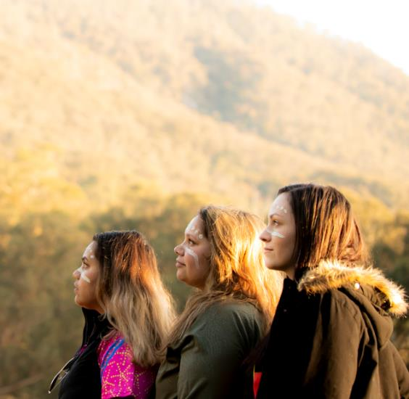
Building VACCA’s evidence base
Documenting our approach to working with children and families
Identifying outcomes and measures of success
Building evaluation systems, policies, procedures and tools

Slide 9
Cultural Therapeutic Ways
Agency approach to guide VACCA’s practice of healing for Aboriginal people, as well as creating a safe and supportive workplace for staff
Intersection of cultural practice with trauma informed theories and self-determination
Articulates how we will work with children and families

Slide 10
VACCA’s Outcomes
Empowerment VACCA clients understand and are empowered to exercise their rights – and discharge their associated obligations – as First People
Culture Culture is embedded in VACCA clients as a resource to draw on for strength, resilience and healing
Safety VACCA clients are safe – and feel safe – and are supported to make safe lifestyle decisions through family and community relationships
Health and Wellbeing VACCA improves the physical, social, emotional and spiritual wellbeing of its clients.

Slide 11
Evaluation
Building Aboriginal programs and practice
Centrality of self-determination
Recruiting and training of internal team
Redefining and leading partnerships with external evaluators
Developing Outcomes important to Aboriginal people
Embedding evaluation into practice

Slide 12
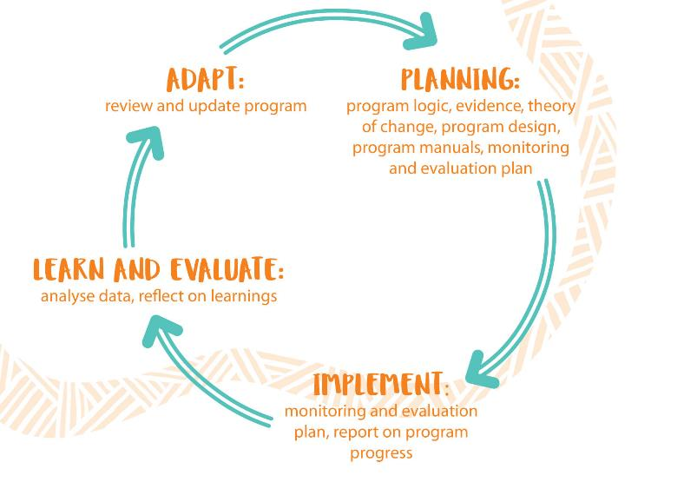
VACCA’s Evaluation Framework
VACCA has drawn inspiration from the adaptive management cycle, DPIPWE 2014, Jones 2005, 2009, as cited by Better Evaluation, https://www.betterevaluation.org/en/evaluation-options/adaptive_management

Slide 13
What have we learnt?
Indigenous evaluation knowledge and skills is critical
Evaluation needs to be resourced across programs
Funding submissions need to reflect all stages of evaluation across program implementation
Skilled research and evaluation staff and project management (or good partnerships)
Program staff need to be trained and supported to engage effectively in evaluation

Slide 14
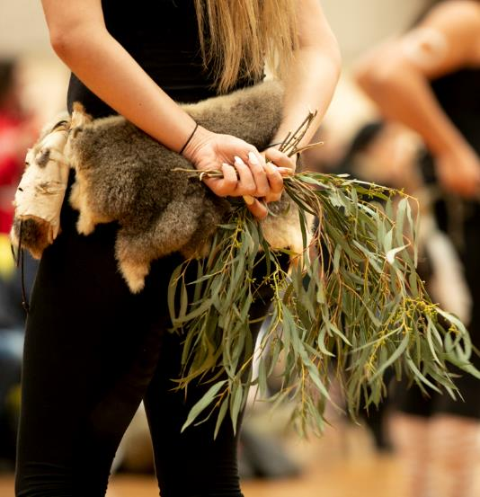
Building systems and capability
Long-term implementation planning
Review and development of policies and frameworks
Evaluation is everyone’s business
Approach needs to be empowering for program staff
Impact of managing external evaluations

Slide 15
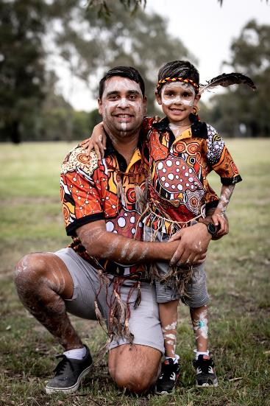
Conclusion
As an ACCO VACCA knows what works for our local communities
We need to develop evidence of the programs we have designed with local communities and are delivering
Self-determination needs to be at the core of our work and a key principle in evaluation partnerships
We need to conduct and advocate for ethical and rigorous evaluations that are culturally appropriate
Tell the story we want to be heard - what outcomes are important to Aboriginal people

Slide 16
Questions?

