Slide 1



Keeping Safe Together
Program evaluation findings
Patrizia Favorito, Women’s Health West
Anneliese Spiteri-Staines, University of Melbourne
Notes:
Leave this in the background prior to starting presentation.

Slide 2

Who we are
Keeping Safe Together (KST) was a pilot program designed to meet the needs of all family members in circumstances of family violence
Co-lead by Women’s Health West and Lifeworks
In collaboration with the Bouverie Centre
Notes:
30 seconds
Presenter: PF
What am I here to present on?
The experiences of children, women and men in the KST program
What worked well and what challenges we faced
The way forward
Women’s Health West provides specialist family violence services to women and their children. We also run prevention programs that promote equity and justice for women and girls in Melbourne’s west.
Lifeworks:
Lifeworks aims to promote safe, respectful and fulfilling relationships and supports all relationships through life’s stages.
The Bouverie Centre provided clinical input and documented practice learnings.
The University of Melbourne conducted an independent evaluation.
Other partners:
Good shepherd Catholicare, McKillop

Slide 3

Background of KST
Families experiencing domestic violence who are wanting to stay together and/or relate together safely.
Brought together specialists from:
  family violence,
  men’s behaviour change,
  children’s therapy and
  family therapy.
Individual sessions with each family member, goal of working towards a family session.
Targeted at low to medium risk clients
Notes:
Presenter: PF
There is a lack of service availability for all family members. Developed specifically to trial in Melbourne’s West. There is a large gap addressing the needs of families who stay together or remain in regular contact.
Victim survivors and their children often return to the perpetrator, resulting in cumulative trauma and harm. According to research, the average victim survivor will make five attempts to leave their violent partner before successfully ending the relationship and 50-60 per cent of victim survivors return to live with their violent partner after being discharged from a refuge. There are a lack of services available in Victoria that provide whole-of-family therapeutic support to victim survivors and their children when they choose to stay with or return to the perpetrator. There is also no support available to parents who separate and then co-parent after separation. This results in families becoming isolated and disconnected from potential support, repeatedly cycling through services in a manner that reinforces patterns of violence and harm.
Each family member allocated their own worker, eg men’s worker for the father, children’s worker for the child, woman’s worker for the mother.
While collaborative multidisciplinary practice is not a new concept, implementation of truly collaborative and intensive models is rare.
Because it is rare, there are few examples, guidelines and practice principles available.

Slide 4

KST aims
Create a safe enough space for child and adult family members (individually and as a system) to:
  Understand what family violence is
  Express and explore the impact of violence
  Increase safety
Notes:
Presenter: PF
Program was designed to be voluntary
The outcomes that KST aims to achieve include:
Children:
Parents understand child’s experiences
Increased safety and decreased risk to child
Child has positive experiences of being parented
Increased child wellbeing
Victim survivors:
Able to recognise and understand family violence
Increased safety for self and children
Increased positive experiences of parental and family relationships
Is empowered to make choices to safely leave relationship and co-parent if necessary
Perpetrators:
Accountability for actions and safety of others
Changed behaviour and patterns of coercive control
No longer uses violence
Able to focus on needs of partner and children
Increased positive experiences of parental and family relationships

Slide 5
KST aims
Make perpetrators’ choices to use violence visible and offer them an opportunity to change their behaviour and stop using violence
Positive parenting and family functioning
To develop and refine a practice-led model that informs and provides learnings for the family violence and broader community sector
Notes:
Presenter: PF
Program was designed to be voluntary

Slide 6
KST principles
Child centred
Feminist informed
Attachment informed
Trauma informed
Flexible
Supports and highlights the strengths of the victim survivor parent
Invites perpetrators to take accountability for their behaviour and its impacts
Restorative
Cross sector service coordination and integration
Notes:
Presenter :PF

Slide 7
Methodology of evaluation
Interviews with children, women, men, program staff and referring professionals
Evaluation Project team:
Anneliese Spiteri-Staines
Kristin Diemer
Deb Absler
Cathy Humphreys
Notes:
Presenter: AS

Slide 8
Evaluation aims
Understand how the KST pilot was developed and implemented subsequent to model design
Determine the extent that KST reached its key target service recipients (families experiencing violence)
Understand the broader organisational and service system context impacting on the delivery of KST
Extent to which KST achieved intended outcomes
Evaluation strengths and limitations of KST model
Notes:
Presenter: AS
This slide includes a subset of the aims of the evaluation, for which the findings will be discussed.

Slide 9
Findings:

Slide 10

Demographic data
Since the program started and data collection finished, 77 families had participated in KST.
  34 children between 9 months and 19 years
  36 women between 23 and 55 years
  22 men between 27 and 50 years
Notes:
Presenter: AS
Most files were still “open” at the time of evaluation, meaning that clients had not exited the program. Completion dates were only recorded for a few clients—most KST clients remain clients until they actively withdraw from the program.
Clients can return on an as needed basis.

Slide 11
Demographic data
Interviewed in this evaluation
8 children (7-15 years)
8 men
8 women – 6 still in relationships with their abusive partner
Notes:
Presenter: AS
The two women who were no longer in a relationship with their ex/partner separated during their time at KST.
Most files were still “open” at the time of evaluation, meaning that clients had not exited the program. Completion dates were only recorded for a few clients—most kST clients remain clients until they actively withdraw from the program.
Clients could return on an as needed basis.

Slide 12

Women’s voices
Increased domestic violence literacy/validation
Empowered to make decisions
“[I can now] honour my own experiences rather than forgive things that are unforgivable. Reclaim control and power using language.” (ID W4)
“Stopped blaming myself for what he is doing.” (ID W1)
“I feel more able to tell [him] what is acceptable behaviour…Also prepared to leave him and knowing this has impacted on his behaviour.” (ID W1)
Notes:
Presenter: AS
Their increased DFV literacy and validation of experiences helped them to become empowered, to find their voice and to stand up to the men who had been abusive to them.
Women were empowered to make decisions about their circumstances, eg whether to leave
Knowing that the men had ‘eyes’ on them through the KST program helped women to feel more empowered to make a choice. Knowing they had a place to go for help, seek advice, time and space to plan to leave.

Slide 13
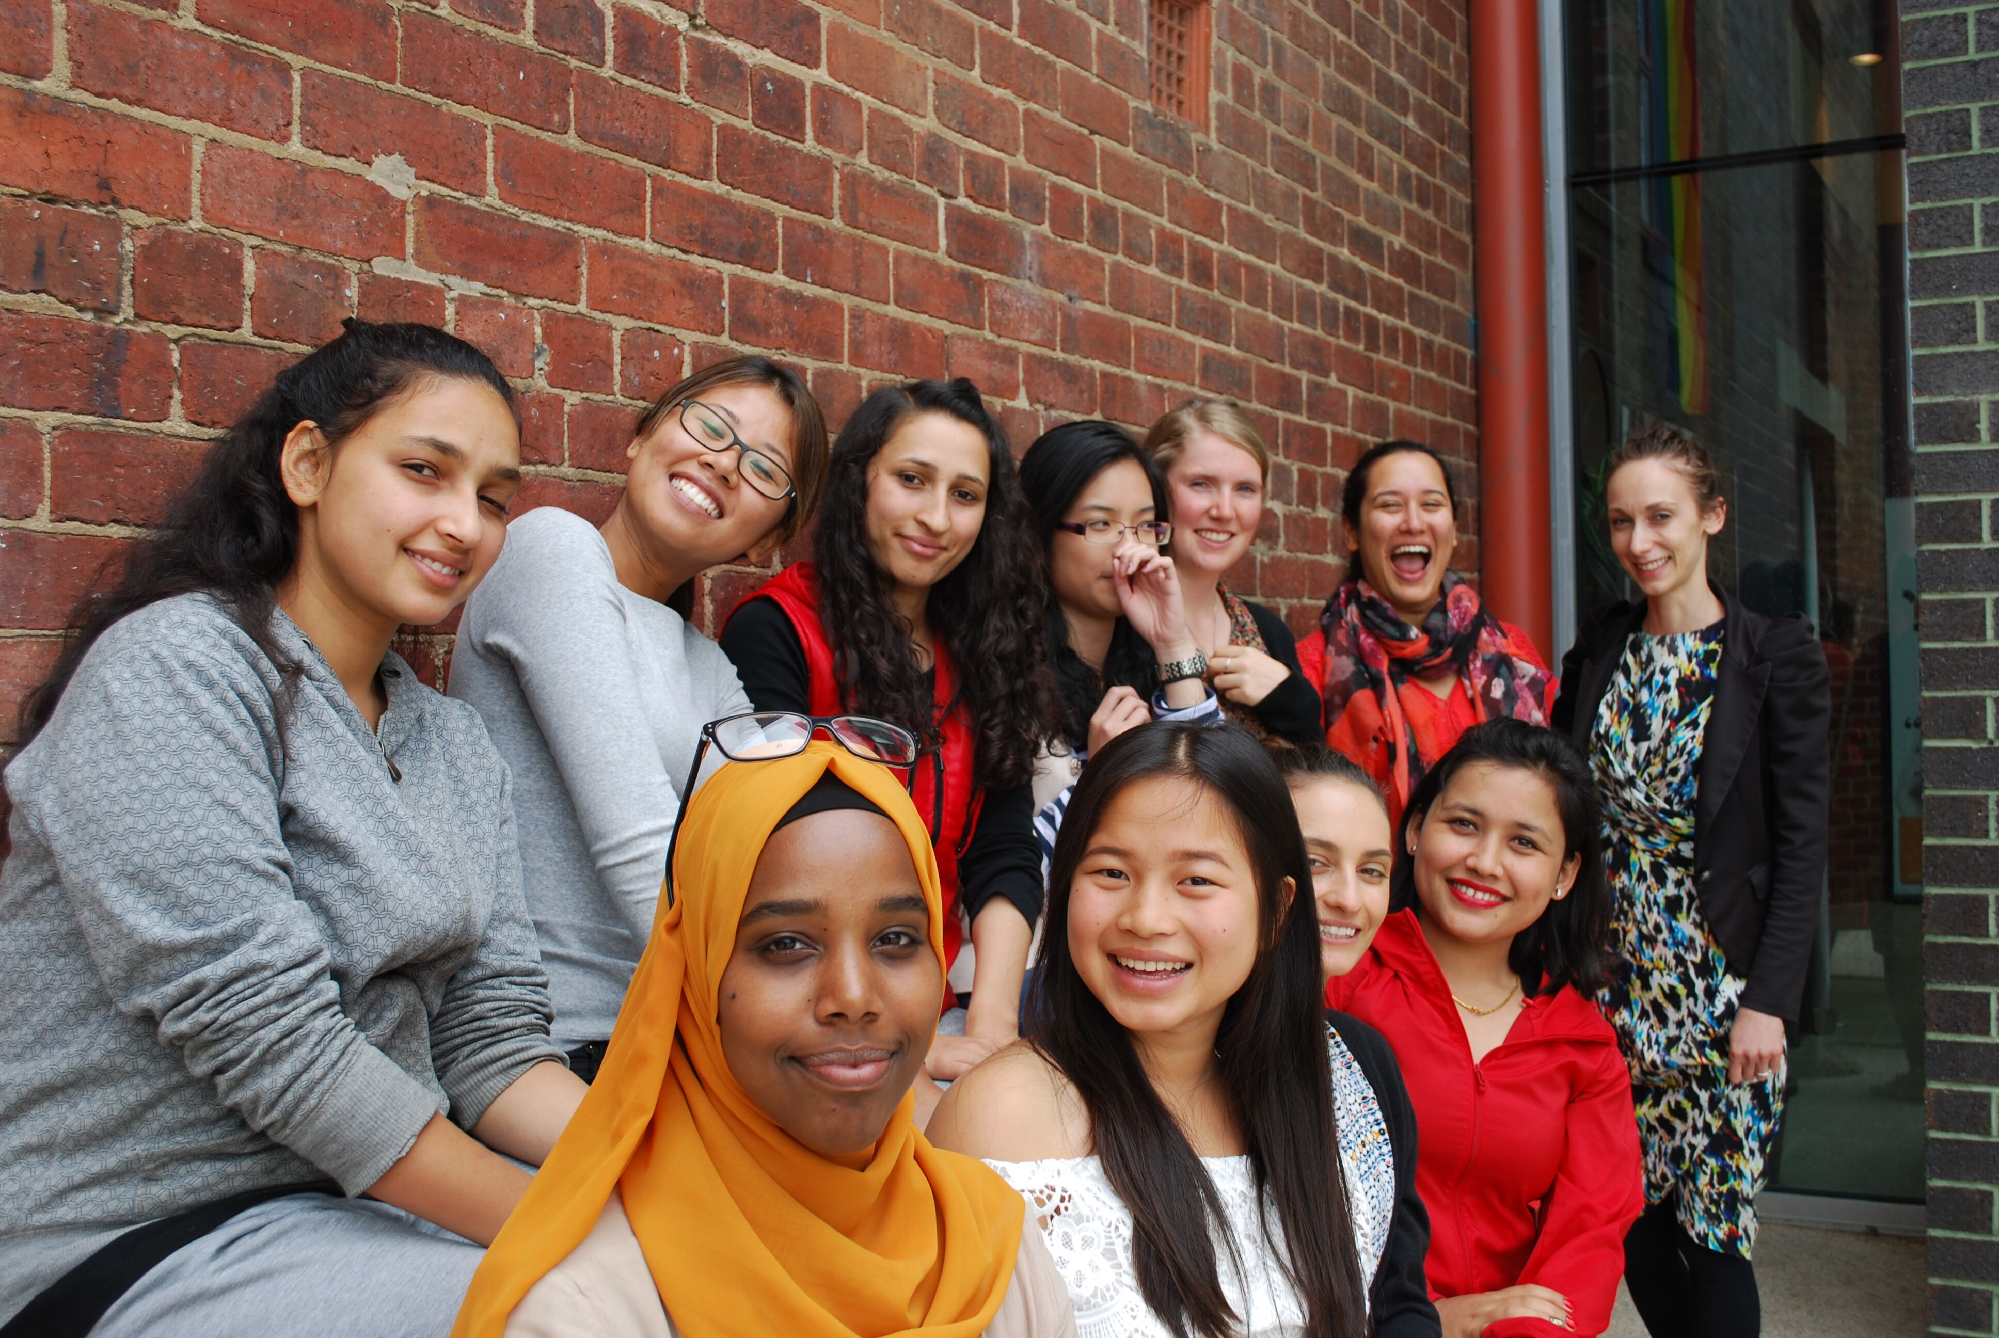
Women’s voices
Most women identified a change in their ex/partner
“No finger pointing…If there had been blaming [he would have] a knee jerk reaction rather than allow a space to be educated. [He] had not realised he was violent and he was supported in learning about his behaviour without finger pointing”. (ID W4)
Notes:
Presenter: AS
This group of women represents a particularly important group of women who otherwise would not receive a service. Most women who stay in the relationship with their abusive partner are excluded from most DFV services.
They spoke of him being less demanding and abusive while her fear also decreased
One woman attributed the change to her ex/partner not to being watched, but to the approach KST took with perpetrators, that their stories were listened to

Slide 14
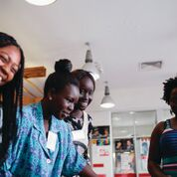
Women’s voices
The all of family approach was very important to women
“The name of the program is important—like with Safe Steps you are thinking about the steps to safety, but with KST you will come along because of the family.” (ID W8)
Notes:
Presenter: AS

Slide 15
Men’s voices
Appreciation for the whole of family approach
“Added benefit of whole family. It’s convenient, affordable, greater scope than individual counsellor.” (ID M4)
Need for rapport building
Most recognised that their behaviour could be improved.
  “Good [stuff] comes out of program. If not for that, I would have breached the [intervention] order…” (ID M3)
These interviews highlighted the need for flexible, extended programs
Notes:
Presenter: AS
Need for rapport building and engagement in order to get men to a point of accepting responsibility for their behaviour
Some men, however, had not yet benefited from psycho-education. These men were resistant to taking responsibility at the time of the interview
Even though some men were not able to fully take accountability for their actions, most recognised that their behaviour could be improved.
The combination of individual sessions as well as the prospect of couple and/or family sessions does keep men engaged in the program.
Furthermore, diversity in readiness to change also emphasizes the need for multiple pathways to access support.
Men’s access to programs is not limited in the same way that women’s access is, that is programs don’t usually discriminate whether he is in a relationship or not. Whereas women’s services are often only provided when the woman is planning or has left the relationship.
However men usually find themselves in DFV programs at the point when their relationships have failed. KSt provides them with a proactive approach to trying to keep their relationship with their partner.

Slide 16
Men’s voices
Intended to stay engaged, at least for the short-term
“Lots of incentives to share thoughts…Not being criticized. Makes you feel comfortable. Someone listening, someone cares.” (ID M5)
Helped to see things differently
“[I] need to take responsibility for my actions –no matter how much they [ex/partner] drive me nuts.” (ID M1)
Notes:
Presenter: AS
All the men illustrated a non-aggressive engagement with KST
All the men identified that they were genuinely gaining something from KST and intended to stay engaged, at least for the short-term
Some men were grateful for the counselling and education they received to help them see things differently
The combination of individual sessions as well as the prospect of couple and/or family sessions does keep men engaged in the program.

Slide 17

Children’s voices
Living with violence was scary, stressful, overwhelming
“Very scary and you felt like you didn’t have a home.” (ID C7 9 years old)
Experienced difficulties at school, with friends, not being able to concentrate on their work, not trusting anyone.
Notes:
Presenter: AS
Children were extremely articulate about the unsafe environments in which they had been living and the far-reaching impacts this had on their development.
In a few situations children provided specific details of police involvement as a result of parents fighting, including being interviewed themselves and seeing their parents removed.
We can underestimate the devastation and terror felt and experienced by children in these situations.

Slide 18
Children’s voices
Said that things had calmed down at home since being involved in the program
“I am not scared of Dad anymore. He’s changed because of the counselling” (ID C4, 9 years old)
“I don’t want to be negative about Dad, but it’s calmer…He…speaks softer – there is way less yelling and doesn’t hit us anymore” (ID C3, 8 years old)
“To talk about things and how to make them better” (ID C7, 9 years old).
Notes:
Presenter: AS
Children valued having someone to talk to about their worries.
Children were extremely articulate about the unsafe environments in which they had been living and the far-reaching impacts this had on their development.
In a few situations children provided specific details of police involvement as a result of parents fighting, including being interviewed themselves and seeing their parents removed.
Some implied that because of their parents’ situation, their parents were not as available to provide the support they needed and thus this aspect of KST was particularly important

Slide 19
Strengths
Including a diverse variety of cross-disciplinary staff and upskilled them to work collaboratively with victim survivors, perpetrators and children.
All clients – even the most resistant - found value in this program.
The flexible and one-on-one approach enabled responses to be tailored to each family’s needs
Notes:
Presenter: PF
Traditionally, DFV programs have not supported a therapeutic approach with violent perpetrators. However, it is unlikely a program can support a man to change his behaviour to his children unless he examines his own experiences of being father– a therapeutic and trauma-informed approach, without losing focus of their accountability.
Similarly, how does a woman continue living with a man who has brutalized or sexually assaulted her without prioritizing a need for him to be accountable for his actions– a feminist DFV informed approach.
The work with women went well, and was an area that should be retained.

Slide 20
Challenges
Lack of on-going engagement by referrers with the program
Attracting an early intervention client cohort vs Child Protection and Family services referrals
Lack of engagement of some families
Notes:
Presenter: PF
KST team undertook significant work in promoting the program through the referral network, often with an enthusiastic response but without clients being referred.
Child Protection and family services have been primary referral points, though KST was not designed with CP in mind as they are usually at the higher end of the risk scale.
Due to the statutory nature of CP, some families did not attend voluntarily– this could be related to referral pathways and some families not entering KST in a purely voluntary fashion. E.g. they meet their Child Protection requirements to attend and thus stop attending KST.
Referrers who did send clients spoke very strongly about the need for the KST program. They reported that it filled a service gap and was the only place they could refer a victim survivor who did not leave her partner.

Slide 21
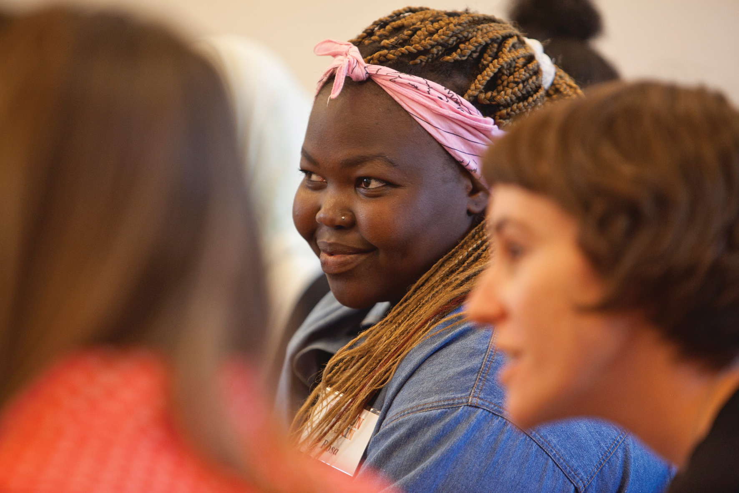
Challenges
Design a tailored response with multiple theoretical and practice approaches
Workforce challenges
Notes:
Presenter: PF
Intersecting between a therapeutic approach informed by a family violence feminist framework, alongside family therapy, individual counselling and psycho-education.
While workers in the DFV sector have previously advocated for collaborative practice, there hasn’t been funding to develop this model. KST was at the cutting edge of new developments in practitioner learning and service delivery for DFV clients.
Workforce: availability and skills

Slide 22
Where to from here?
Opportunity for ground-up development of multi-practitioner informed guidelines for a new approach to working with families
Could involve:
  Mother-child strengthening work
  Restorative justice
  Shuttle mediation
  Family and Couple counselling (where safe to do so)
Access to clinical supervision and cross-sector skill development needs to be further
Prioritization of children’s voices
Notes:
Presenter: PF
While workers in the DFV sector have previously advocated for collaborative practice, there hasn’t been funding to develop this model.
KST was at the cutting edge of new developments in practitioner learning and service delivery for DFV clients.
The collaboration between organisations and ways to do this both strategically and operationally has been an important learning.
Access to clinical supervision and cross-sector skill development needs to be further developed in order to realise the model as it was intended, and to support practitioners to do the work as intended.
Prioritization of children’s voices:
As seen in the findings, quite a few fathers were not considering their impact on their children as much as they should. It was suggested that fathers could meet directly with the child practitioner, without the child present. The session could be conducted in a safe manner by more generally focussing on psychoeducation about the impact of violence/abuse in the family on children. While psychoeducation on parenting was conducted by the men’s practitioner with the father already, it may have a stronger impact when the father is hearing from someone working directly with his child(ren).

Slide 23
Where to from here?
There is a need to challenge funding silos
Need for intensive all of family therapeutic approaches and roll out tried and tested models across the state / Australia.
Takes courage and persistence to continue doing this work and to develop the skills and capacities of the workforce.

Slide 24


Thank you!

