Slide 1
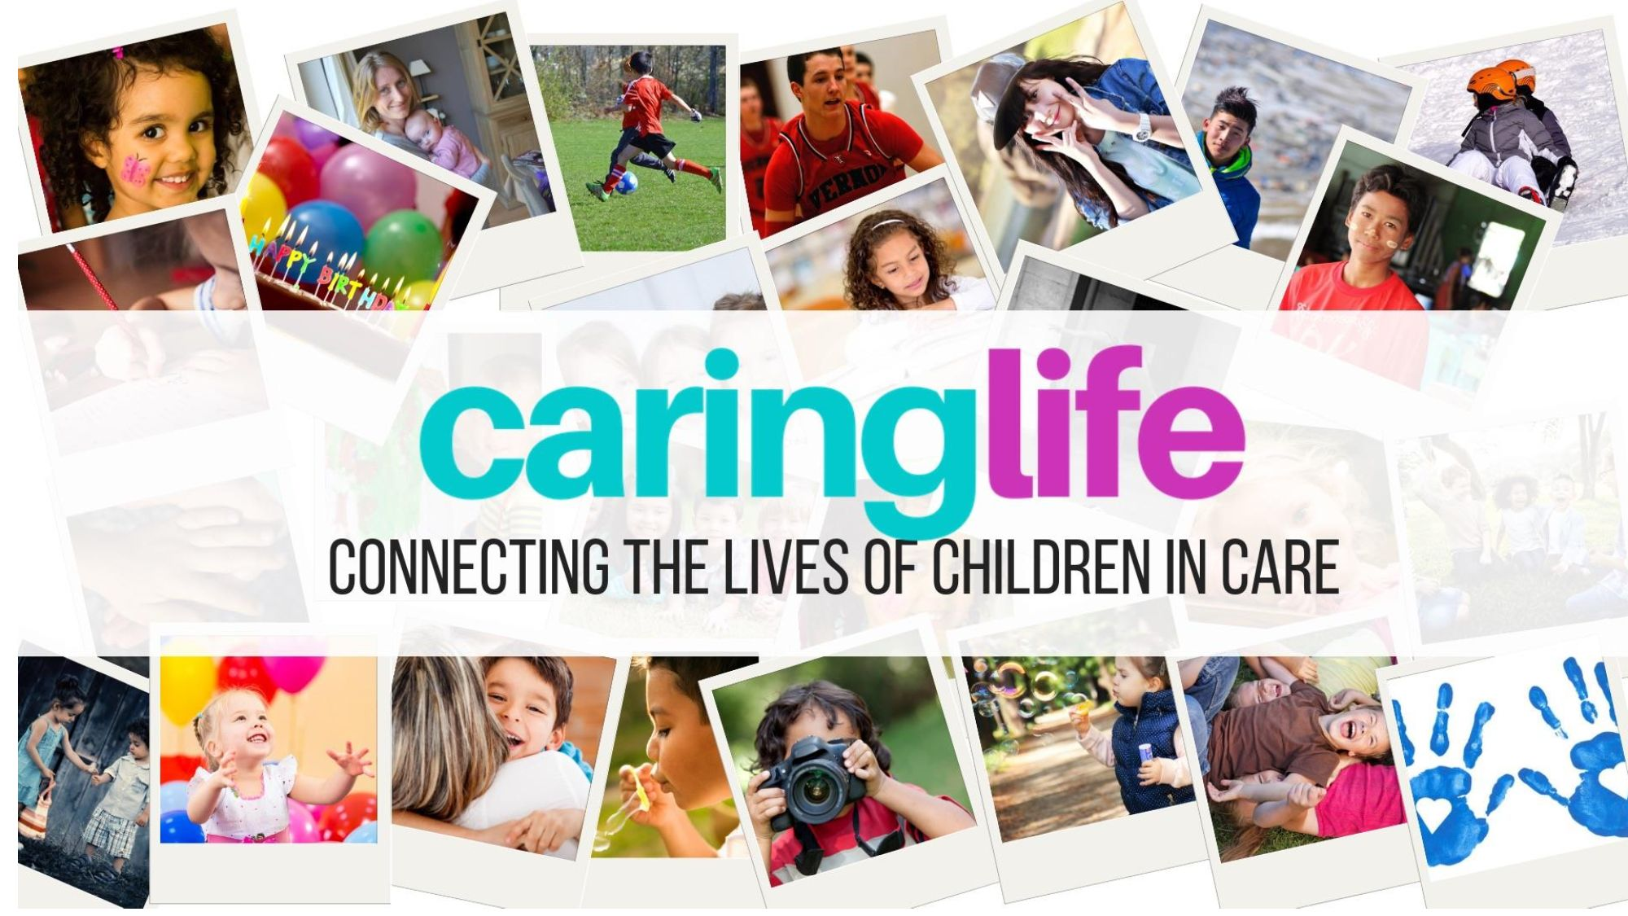

Proudly supported by

Slide 2
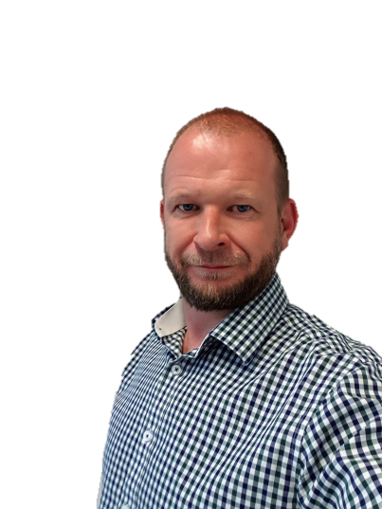
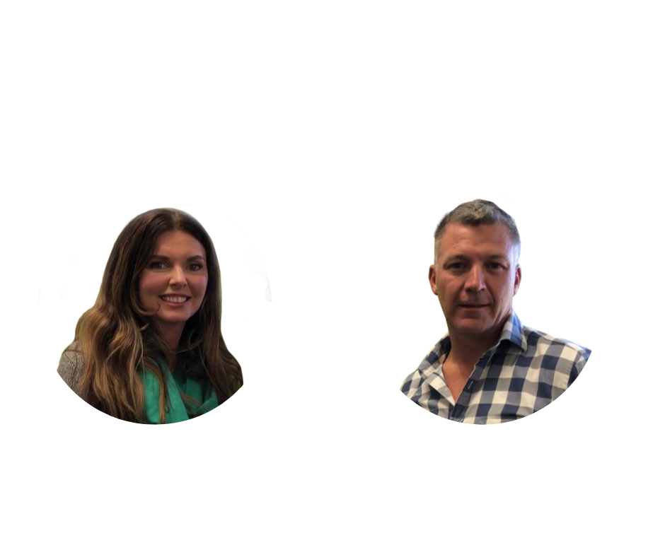
Hello, we are
Jonathan
Emma
Anthony

Slide 3
We acknowledge the traditional owners of the land on which Arts Centre Melbourne stands, the People of the Kulin Nations, and pay our respects to their elders, past, present and future

Slide 5

We are Caring Life
Notes:
Emma and Anthony to introduce themselves

Slide 6
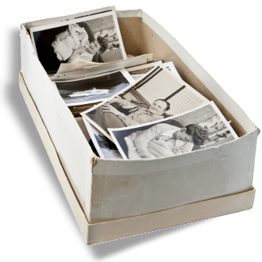

A Priceless Box
Who has something similar to this box?
How important is it to you?
I imagine incredibly important.
Does it hold celebrations, photos of loved ones, achievements and reflective moments.
Does it hold your life story?
Notes:
It helps you to explore, question and understand the past events of your life.
Some of us carry our memories, experiences and events around cognitively, some in a box and some more formally through Life Story work.
Overall, our life story helps us develop a healthy sense of self and a feeling of wellbeing.
In fact 46% of people save this box/photos when there is a fire at their home
*source RACQ home fire safety index 2015

Slide 7
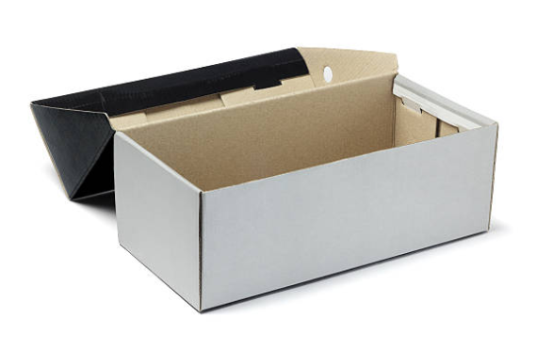
Now imagine having lived in 11 different homes over the last 7 years
Maybe coming from a birth family in crisis
This is often the case for children in care
Who and how are we taking care of their priceless childhood memories?
Notes:
Children in OOHC face a major problem in having access to life moments, memories, photos, videos, awards and achievements.
Record-keeping is a major problem for children in OOHC, with children either given these life moments in a scrapbook or USB stick. Often, however, transitions between care placements can happen so quickly that the carers don’t have time to give these important memories to children – and they are lost forever.

Slide 8


Mental Health and Identity
Research shows that the concepts of identity and belonging are key predictors of mental health in children-in-care, as well as the feeling of security and permanency*.
A fragmented, damaged, discontinuous personal narrative puts an individual child at risk.
Without a life story, a child is adrift, disconnected and vulnerable - their neurobiology of reward, stress regulation and relational interactions are all altered - in negative ways - without a cortically mediated coherent personal narrative.
Adjunct Associate Professor Richard Rose, Director of Child Trauma Intervention Services Ltd
Notes:
Research has also demonstrated that these children and young people are impacted by the lack of identity and belonging, an issue that is compounded by the high number of placement changes.*
Johnson, Natalier, Liddiard, and Thoresen (2011)examined the placement history of 77 young people who had been in out-of-home care in Victoria and Western Australia and found that 40% of the sample had experienced between two and five placements, 14% between six and 10 placements, and 32% had moved between placements more than 11 times.

Slide 9

Life Story Work
Therapeutic Life Story Work enables children and young people who have experienced the trauma of child abuse and neglect and who are struggling with the pain of their past to reflect, develop compassion for themselves and move on.
CSOs and carers are required to collate placement details, records of life experiences and achievements, school reports, medical records, photographs of meaningful and significant events, people involved in the child’s life and keep it in a safe place so the child may take such memories with them when changing placement or leaving care.
This is very challenging if you are bouncing around the system!
Notes:
- Program Requirement 1.6.5 of the Program Requirements for Home Based Care in Victoria. This requirement is not being properly met by most agencies, who freely acknowledge that life story work is often haphazard.
- Due to bounce Life Story work is often overlooked and the current methods of collection and management of memories aren’t working

Slide 10

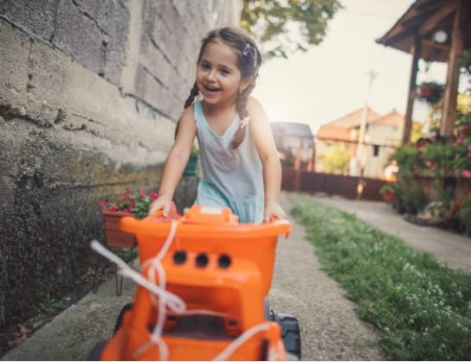



Currently
No system - worldwide - that provides for the central storage of memories
Children are often given these mementos in hard-copy form or on a USB stick, which are easily lost, particularly when the children move between carers.
These moments are priceless, and form part of the child’s identity and life story
Notes:
EMMA AND ANTHONY TO SHARE THEIR STORY OF WHY THEY CREATED CL
Carers often take a lot of photos and videos of significant moments of the child’s life –it could be their 5th birthday party, a trip to the zoo, holidays, family gatherings, or any of the usual family moments.
Then there are sporting achievements and certificates, school reports and other important documents.

Slide 11
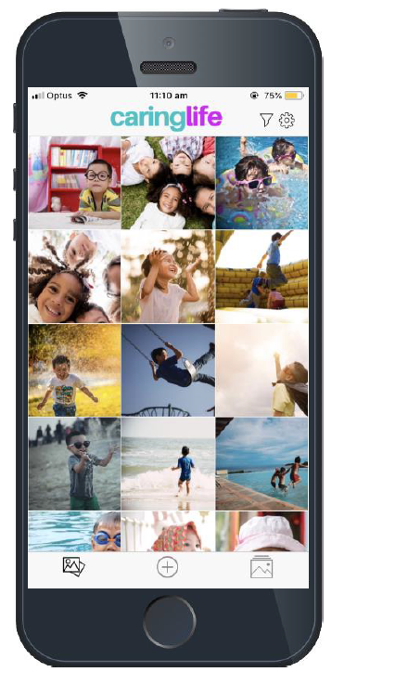
Welcome to CaringLife
CaringLife enables agencies to achieve their life-story requirements in a quick and safe way.
Carers, agencies, case managers and children are able to upload, moderate and see the photos and other files.
Developed with a deep understanding of the Life Story therapy approach that is developmentally sensitive and trauma-informed.
Even when children leave care, or transition into adulthood, they will have on-going access to all their content.
Notes:
It enables content to be uploaded by the carer to the child's account either on website or phone app, to be viewed and moderated by the child's agency and case manager, and to be available to the child so that none of their precious life moments are lost. If the child is transferred to another foster family, the ability to upload content is transferred to the new family and the child can save and see content from previous foster families they have lived with, and thus have access to a continuous "life story".
This has helped to develop functions to ensure that children are exposed to content at age-and developmentally-appropriate times.

Slide 12
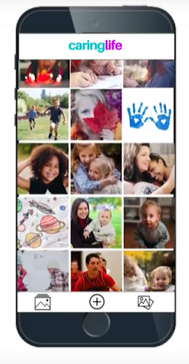
CaringLife
A range of APIs are being developed to ensure that CaringLife can integrate with a wide range of CRMs, to remove duplicity of work and ensure efficiencies for foster agencies and case managers.
CaringLife is NOT a social platform
It’s designed to be a very secure and private “Dropbox” style system that allows the children to be able to see all their life memories now and into the future.
Notes:
Caring Life provides an easy way for carers, agencies, case managers and children to be able to upload, moderate and see the photos and other files, through a highly-secure Software as-a-Solution (SaaS) platform.

Slide 13



A Modern-Day Memory Box
Therapeutic and identity benefits for children in care – the app allows children to form a continuous life narrative and sense of identity and belonging, which has a direct relationship with mental health outcomes.
Regulatory compliance under the Program Requirements for Home Based Care in Victoria (1.6.5)
It has been identified as a therapeutic resource by the Australian Childhood Foundation and Professor Richard Rose.
Notes:
All the benefits of how you solved the problem

Slide 14
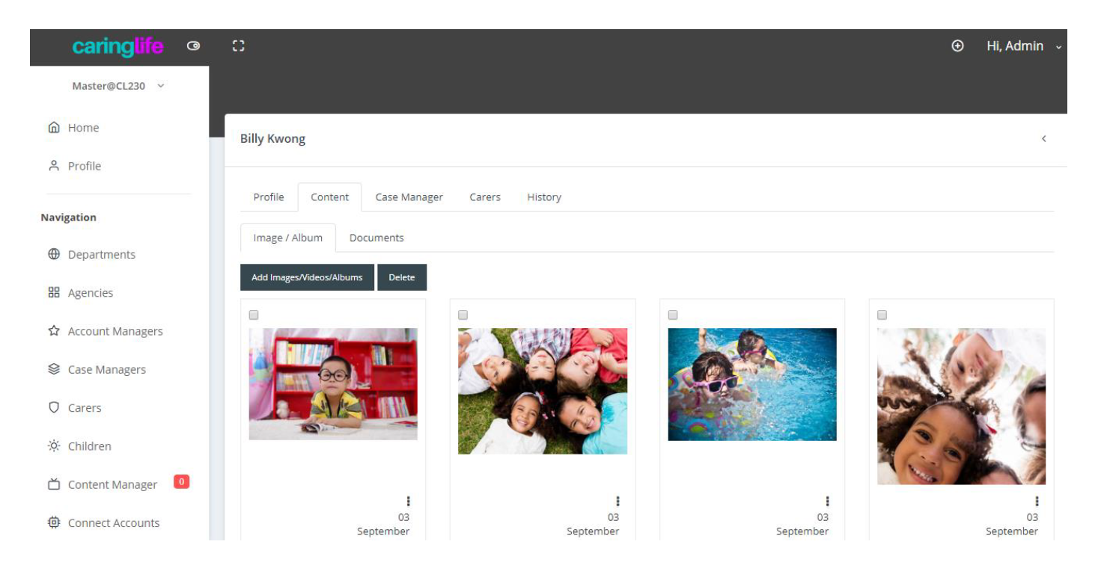
In Action
Carers and children each have their own private account created on CaringLife, which are then connected when a child is staying with that carer.
Notes:
Carers-Once connected to a child, carers can upload content to their account which is then also visible on the child’s account. This
content will only be visible to the carer, the child and the child’s case manager.
Children –Children are able to add their own content to their account to ensure that they feel that they are contributing freely to their own life story and are creating their own memories. Content uploaded by the child will only be visible to the child and their case manager unless the child chooses to share it with their carer via a "Share with my carer" option.
The photos are stored at high-resolution to ensure the children can download and print the photos if they wish.
Case Managers –Case Managers are able to monitor all the content that is uploaded by either the child under their
responsibility or their carer, and can delete any content that they deem inappropriate. They are also able to add content that they may feel is important to the child –for example if they receive photos, videos or other documents of the child from previous carers, they can upload them for the child.

Slide 15
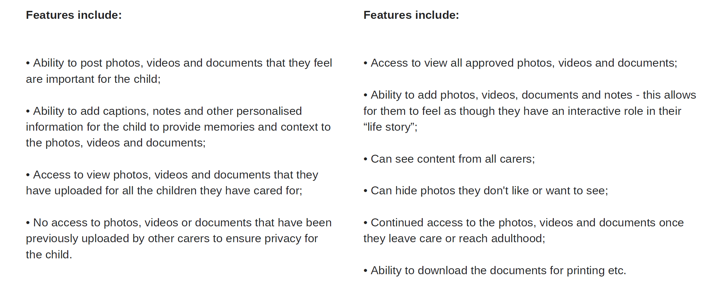
The Specifics
Carers
Child

Slide 16
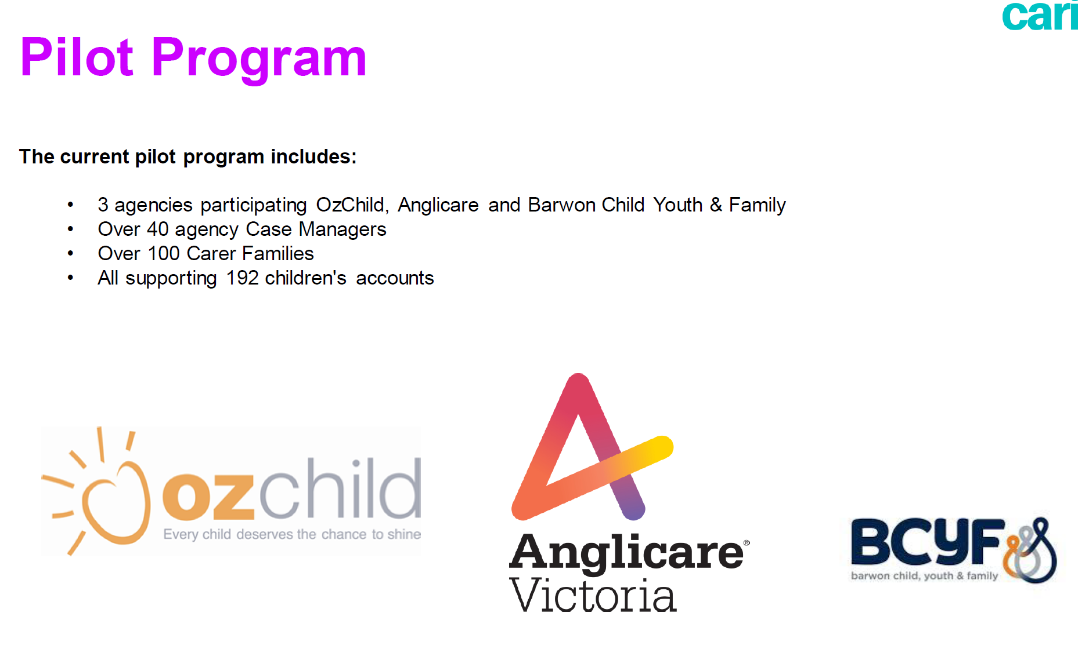


Pilot Program
Notes:
The Pilot Program has demonstrated high levels of engagement, with over 6000 unique pieces of content uploaded, and regular engagement by children, carers and case managers.
Talk about length of program etc

Slide 17





Pilot Program Statistics
Each carer family has
More than 6500
uploaded on average,
58 unique pieces
photos, videos and other content have been uploaded
of content
Carers upload content, on average, twice a week
59%
32%
9%
are photos
are videos
are documents
100%
of carers surveyed as part of the pilot program said that they would recommend CaringLife to other carers

Slide 18



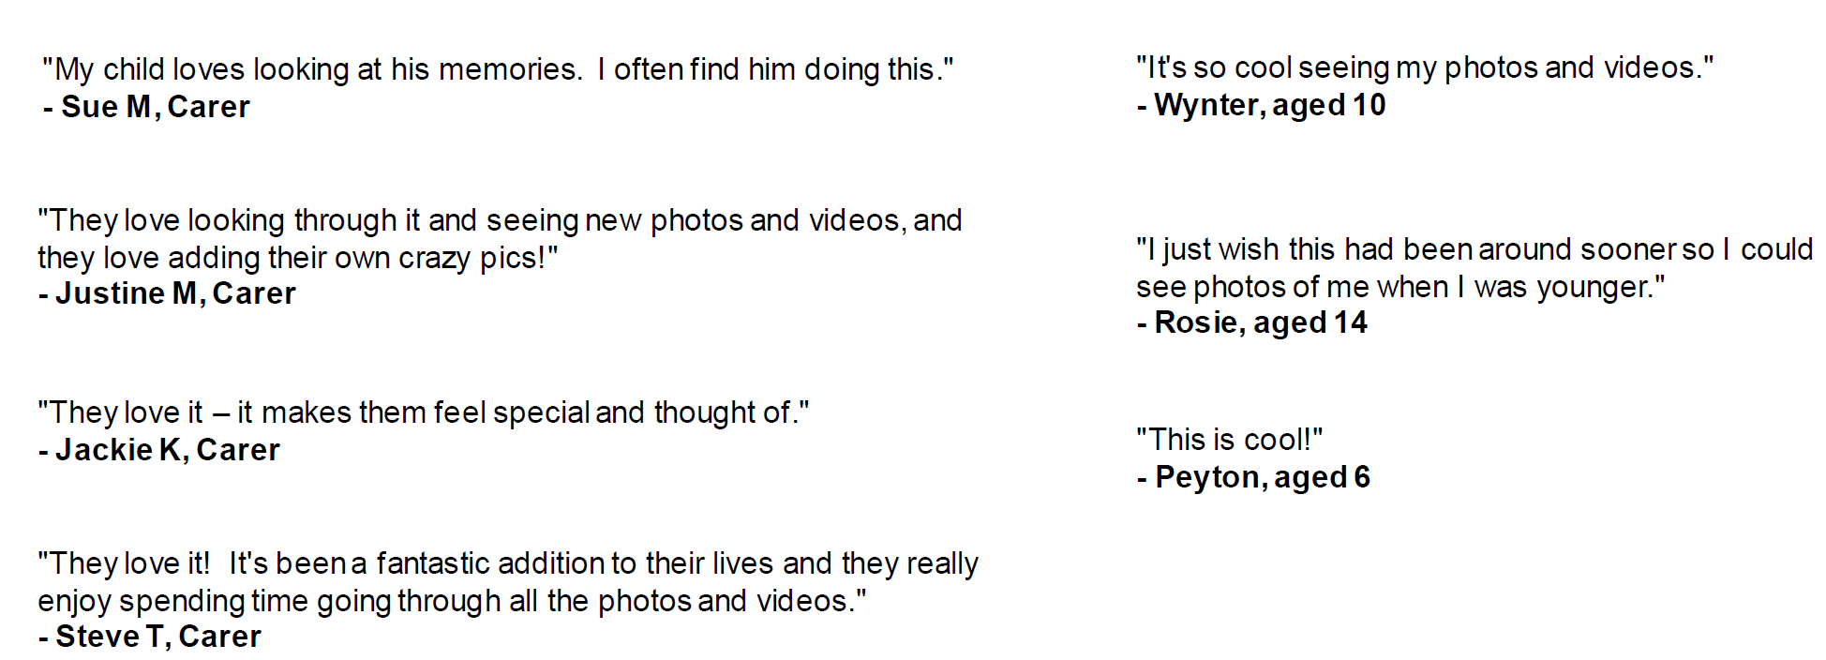
Feedback from Pilot Program
“My child loves
looking at his memories. I often find him doing this.”
- Sue M, Carer
“It’s so cool seeing my photos and videos.”
- Sarah, aged 10
They love it – it makes them feel special and thought of.
- Jackie K Carer
They love it! It’s been a fantastic addition to their lives and they really enjoy spending time going through all of the photos and videos.
- Steve T, Carer
I wish this had been around sooner so I could see photos of me when I was younger.
- Jane, aged 14
“They love looking
through it and seeing new photos and videos, and they love adding their own crazy pics!”
- Justine M, Carer
“This is cool!”
- Iain, aged 6

Slide 19




Our Supporters

Slide 20
Our Supporters
“Having access to Childhood memories is something parents in everyday life take for granted, so ensuring our children in foster care have their own private access to memories, they create, through CaringLife is an incredible innovation and an absolute right for all children and young people in the care system.”
Dr Lisa Griffiths, CEO, OzChild
Notes:
We’ve worked closely with Richard Rose – discuss journey with Richard

Slide 21
Our Supporters
“The CaringLife app has utility as a therapeutic tool through which children and young people can connect with their carers using the non-threatening, safe and private media platform in the app.”
Janise Mitchell
Deputy CEO - Australian Childhood Foundation
“A fragmented, damaged, discontinuous personal narrative puts an individual child at risk. CaringLife provides a terrific way for children to be able to access their life moments in an easy and continuous way, and I support the use of CaringLife for children in out-of-home care.”
Associate Professor Richard Rose
Director of Child Trauma Intervention Services Ltd
Notes:
We’ve worked closely with Richard Rose – discuss journey with Richard

Slide 22

Compliance
Comprehensively tested and assessed through testing by external security agency
All data is hosted and stored in the child's country of residence
The system and the data storage, which is AWS cloud-based, align with security best practices and a variety of IT security standards including:
SOC 1/SSAE 16/ISAE 3402 (formerly SAS 70)
SOC 2
SOC 3
PCI DSS Level 1
ISO 9001 / ISO 27001
ITARFISMA, DIACAP, and FedRAMP
FIPS 140-2
DOD CSM Levels 1-5
MTCS Level 3
(200,000 hacking attempts over 4 days)
Notes:
And we’ve ticked all the compliance boxes!

Slide 23





Our Journey to Today
About 2500 hours of our time
55 CSO
meetings
500
7
DHHS
Funding still
MEETINGS
USERS
in negotiation
WINNER OF 2019
725
DEVELOPMENT
Child Protection Award
for Innovation
HOURS

Slide 24
What’s Next
Working in collaboration with the Indigenous community to ensure the system properly reflects Indigenous culture and requirements.
Rolling it out to 1000 children in Victoria
Thank you

